Slide 1
Cysteine proteinases regulate chloroplast protein content and composition in tobacco leaves: a model for dynamic interactions with ribulose-1,5-bisphosphate carboxylase/ oxygenase (Rubisco) vesicular bodies
Results
Cysteine proteinases (CPs) are involved in Rubisco turnover in leaves under optimal and stress conditions.
Extra-plastidic Rubisco Vesicular Bodies(RVB) involved in degradation and trafficking of Rubisco to plastid

Slide 2
What is Cysteine proteinases (CPs)?

Slide 3
What is Cysteine proteinases (CPs)?
Processing and degradation of seed storage protein.
Involved in fruit ripening and senescence specific.
induced due to wound, cold ,drought & HR response.
Involved in signaling pathway in response to biotic and abiotic stress (in plants)

Slide 4
Focus of the Study
How rice Cysteine Proteinase (OC-1)
Alters concentration and composition of leaf protein in tobacco?
Affect photosynthesis at different growth stage?
Mainly focused in Rubisco because it is an abundant protein in plant leaf

Slide 5
Some terms
Cystatin= Cysteine Proteinase
Oryzacystatin-1 (OC-1)= Cysteine Proteinase from Rice
OCE plant= Tobacco pant in which OC-1 is Expressed endogenously.

Slide 6
Result and Discussion
Leaf protein composition and turnover (protein extracted and separated in 2-D gel electrophoresis.)
Control Leaf= 765 protein spot
OCE Leaf = 860 protein spot
51 spots -> chosen for study.
Difference in volume:
13= not sign. different
7 = Control > OCE plant
26= OCE plant > Control
3 = only in OCE plant
2= In OCE(undetected)
2 spots (4 & 5) differ in vol. between control & OCE leaf

Slide 7
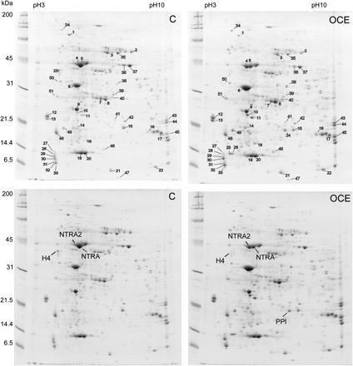
Spot 4-> Homologos to Rubisco activase and Rubisco activase 1
Spot 5-> Homologos to Rubisco activase 1 and Rubisco activase 2

Slide 8
Spot 4-> Homologos to Rubisco activase and Rubisco activase 1
Spot 5-> Homologos to Rubisco activase 1 and Rubisco activase 2
Spot 4 volume in OCE is 2.42 times higher than in Control
Spot 5 Volume in OCE is 2.99 times higher than in Control

Slide 9

Fig: Western blot analysis for relative abundance of proteins in 14 week old plant
Youngest Mature leaf
And 1 is first leaf
Rubisco LSU Protein:
Control plant leaf: has highest only in mature leaf and least in youngest (18) and oldest (1) leaf.
OCE plant leaf: has higher in all ranks(stem, young and old leaves).
Rubisco ActivaseProtein:
Control plant leaf: Two bands in all leaf but only lower band in oldest (1) senescent leaf.
OCE plant leaf: Only upper band (i.e. higher mol. Wt.) in young (19 & 28) leaves. Both bands seen only in oldest leaves (1 & 10). Shows some developmental difference of Rubisco activase

Slide 10
Youngest Mature leaf
And 1 is first leaf
Fig: Western blot analysis for relative abundance of proteins in 14 week old plant
Rubisco LSU Protein:
Control plant leaf: has highest only in mature leaf and least in youngest (18) and oldest (1) leaf.
OCE plant leaf: has higher in all ranks(stem, young and old leaves).
The development-dependent diff. in Rubisco activase protein band is may be due to inhibition of leaf CP
Rubisco ActivaseProtein:
Control plant leaf: Two bands in all leaf. But only lower band in oldest (1) senescent leaf.
OCE plant leaf: Only upper band (i.e. higher mol. Wt.) in young (10 & 19) leaves. Both bands seen only in oldest leaves (1 & 10)

Slide 11
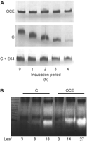
In-vitro study for protection of Rubisco from degradation by OC-1 in OCE plants and by E64 in control plants
+ Endogenous tobacco CP = Rubisco not degraded
+ Endogenous tobacco CP = Rubisco degraded
+ Endogenous tobacco CP + E64 = Rubisco not degraded
E64 is CP inhibitor
Figure showing OCE leaves already had higher CP activities than controls
Feedback modulation of CP expression already present that enhance CP production when activity is impaired by constitutive cystatin expression.

Slide 12
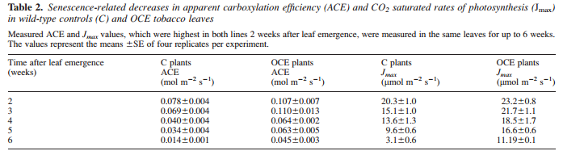
OCE leaves has higher ACE and Jmax value than Control at equivalent stage
Senescence related decline in photosynthesis is delayed in OCE leaves.

Slide 13
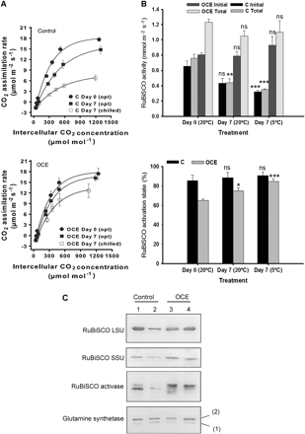
Rubisco Activity
Effect of dark chilling on photosynthesis (A), Rubisco activity and activation state (B) in leaves of control and OCE plant at optimum and chilling temperature
Rubisco activation state
At Day 7 (chilling temperature): Photosynthesis rate sharply decreased in control than in OCE.
Rubisco acivity is similar in OCE plants(B) but decreased in Control.
OCE slightly increased Rubisco activation state than control after 7 day and in chilling.
1 & 3 = at Day 0 an 2 & 4 after 7 nights of dark chilling
Dark chilling decreased the amount of Rubisco SSU, Rubisco LSU and Rubisco activase in control. But, No effect in OCE
No effect of dark chilling in Glutamine Synthetase

Slide 14
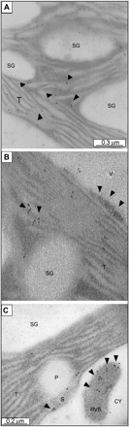
Fig: Immunogold labeling to determine intracellular distribution of Rubisco Protein in control and OCE tobacco leaf (6 week old plant).
Labels detected in chloroplast of palisade cells of control (fig.B) and OCE (fig.C)leaves.
T= thylakoid membrane SG= Starch Grain V=Vacuole
Rubisco protein present in vesicles (RVB) as well as in chloroplast in both young wild type and OCE leaf
Rubisco Vesicular Body outside chloroplast as a link between the protein turnover machinary in chloroplast, cytosol, and vacuoles

Slide 15
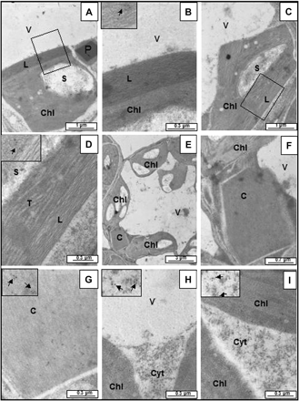
Intracellular distribution of OC-1 protein in control and OCE leaf (6 week old)
Fig. A ,C (are OCE leaf) & B,D showing immunolabel of OC-1 protein in chloroplast
Fig E & F= section of OCE leaf showing Cysteine inclusion body
Fig G= Crystalline structure of OC-1 protein + endogenous CP in cytosol
Fig H & I= showing immunogold label of OC-1 protein in the cytosol of the OCE leaf

Slide 16
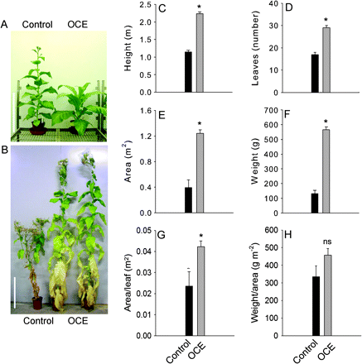
Inhibition of CP activity effects on lifespan and leaf protein and chlorophyll contents after flowering
Due to inhibition of CP, OCE lines have higher lifespan, height, number of leaf, area, weight, area/leaf, Wt./area than controls.
It also avoid stress-induced premature senescence.

Slide 17
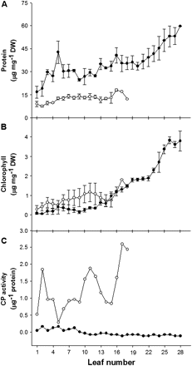
Comparisons of leaf soluble protein and chlorophyll contents and cysteine proteinase activities in 14-week-old OCE and control tobacco plants.
OCE plant
control
Fig A= Leaf soluble protein
Fig B= Chlorophyll content
Fig C= CP activity
Extractible CP activity of OCE leaf is greatly decreased by the presence of OC-1.

Slide 18
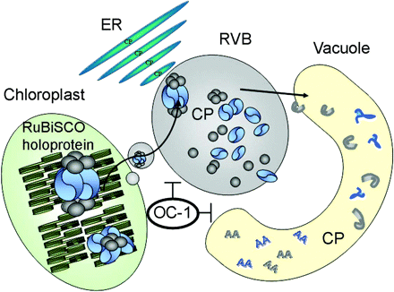
A hypothetical model for Rubisco degradation via autophagy and the plant vesicle trafficking system
Normally, Rubisco protein formed in chloroplast undergo autophagic degradation and RVB trafficking to Vacuole.
But, presence of Cystein Proteinase (here OC-1) in cytosol repress the trafficking, autophagic degradation and its transport to vacuole

